Slide 1
Chapter 2 – Software Processes
Instructor
Dr. Sultan S. Alqahtani
ssalqahtani@imamu.edu.sa
Note: These are a slightly modified version of Ch1 slides available from the author’s site http://www.cs.st-andrews.ac.uk/~ifs/Books/SE9/

Slide 2
Before we start
Course project

Slide 3
Group Project
The practical work for the course will consist of group work (5 – 7 students)
Carry out a substantial design, implementation and test of a system according to course theory.
Practice a waterfall model software development.
Analysis and design take place before implementation

Slide 4
Group Project
A list of projects will be circulated and discussed in class
Students will be instructed as to how to divide up to into group of 5-7 persons
You should meet as a complete group at least once a week
You must attend unless you have strong reasons not to

Slide 5
Project List (TBD)

Slide 6
Project Schedule
Divided into 6 phases of a waterfall model:
Project planning and feasibility study,
User requirements analysis,
Software requirements specification,
Architectural design,
Detailed design and coding
Testing and delivery.

Slide 7
Project Deliverables
Each group will deliver a report at the end of phases 1 – 4.
Phase 5 deliverable is simply code
Phase 6 deliverable is a group presentation of the project for the class, followed by an individual software demo.
Each phase carries equal credit points.

Slide 8
Topics covered
Software process models
Process activities
Coping with change
The Rational Unified Process (Reading)
An example of a modern software process.

Slide 9
Software process models
A software process model is a standardized format for
planning
organizing, and
running
a development project.

Slide 10
Hundreds of different models exist and are used, but many are minor variations on a small number of basic models. In this section we:
survey the important basic models, and
consider how to choose between them

Slide 11
The software process
A structured set of activities required to develop a software system.
Many different software processes but all involve:
Specification – defining what the system should do;
Design and implementation – defining the organization of the system and implementing the system;
Validation – checking that it does what the customer wants;
Evolution – changing the system in response to changing customer needs.
A software process model is an abstract representation of a process. It presents a description of a process from some particular perspective.

Slide 12
Plan-driven and agile processes
Plan-driven processes are processes where all of the process activities are planned in advance and progress is measured against this plan.
In agile processes, planning is incremental and it is easier to change the process to reflect changing customer requirements.
In practice, most practical processes include elements of both plan-driven and agile approaches.
There are no right or wrong software processes.

Slide 13
Software process models
The waterfall model
Plan-driven model. Separate and distinct phases of specification and development.
Incremental development
Specification, development and validation are interleaved. May be plan-driven or agile.
Reuse-oriented software engineering
The system is assembled from existing components. May be plan-driven or agile.
In practice, most large systems are developed using a process that incorporates elements from all of these models.

Slide 14
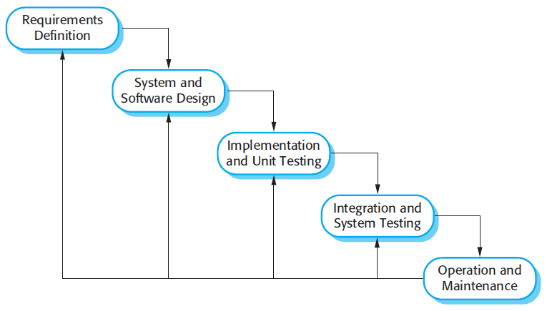
The waterfall model

Slide 15
Waterfall model phases
There are separate identified phases in the waterfall model:
Requirements analysis and definition
System and software design
Implementation and unit testing
Integration and system testing
Operation and maintenance
The main drawback of the waterfall model is the difficulty of accommodating change after the process is underway. In principle, a phase has to be complete before moving onto the next phase.

Slide 16
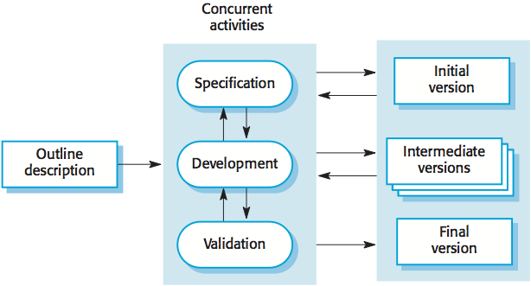
Incremental development

Slide 17
Incremental development benefits
The cost of accommodating changing customer requirements is reduced.
The amount of analysis and documentation that has to be redone is much less than is required with the waterfall model.
It is easier to get customer feedback on the development work that has been done.
Customers can comment on demonstrations of the software and see how much has been implemented.
More rapid delivery and deployment of useful software to the customer is possible.
Customers are able to use and gain value from the software earlier than is possible with a waterfall process.

Slide 18
Incremental development problems
The process is not visible.
Managers need regular deliverables to measure progress. If systems are developed quickly, it is not cost-effective to produce documents that reflect every version of the system.
System structure tends to degrade as new increments are added.
Unless time and money is spent on refactoring to improve the software, regular change tends to corrupt its structure. Incorporating further software changes becomes increasingly difficult and costly.

Slide 19
Reuse-oriented software engineering
Based on systematic reuse where systems are integrated from existing components or COTS (Commercial-off-the-shelf) systems.
Process stages
Component analysis;
Requirements modification;
System design with reuse;
Development and integration.
Reuse is now the standard approach for building many types of business system
Reuse covered in more depth in Chapter 16.

Slide 20
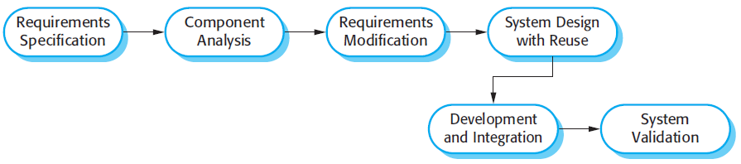
Reuse-oriented software engineering
Notes:
Types of software component
Web services that are developed according to service standards and which are available for remote invocation.
Collections of objects that are developed as a package to be integrated with a component framework such as .NET or J2EE.
Stand-alone software systems (COTS) that are configured for use in a particular environment.

Slide 21
Process activities
Real software processes are inter-leaved sequences of technical, collaborative and managerial activities with the overall goal of specifying, designing, implementing and testing a software system.
The four basic process activities of specification, development, validation and evolution are organized differently in different development processes. In the waterfall model, they are organized in sequence, whereas in incremental development they are inter-leaved.

Slide 22
Software specification
The process of establishing what services are required and the constraints on the system’s operation and development.
Requirements engineering process
Feasibility study
Is it technically and financially feasible to build the system?
Requirements elicitation and analysis
What do the system stakeholders require or expect from the system?
Requirements specification
Defining the requirements in detail
Requirements validation
Checking the validity of the requirements

Slide 23
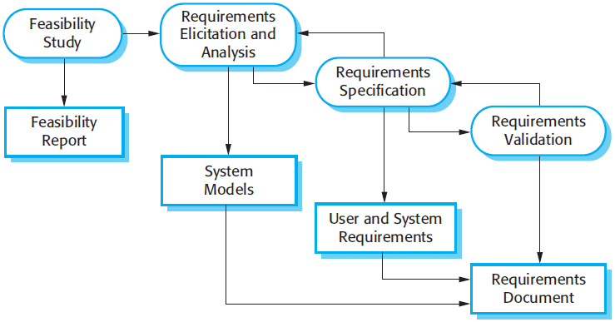
The requirements engineering process

Slide 24
Software design and implementation
The process of converting the system specification into an executable system.
Software design
Design a software structure that realises the specification;
Implementation
Translate this structure into an executable program;
The activities of design and implementation are closely related and may be inter-leaved.

Slide 25
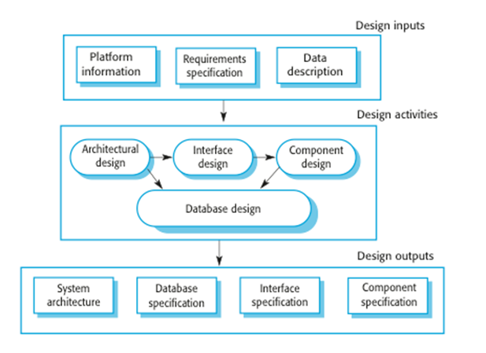
A general model of the design process

Slide 26
Software validation
Verification and validation (V & V) is intended to show that a system conforms to its specification and meets the requirements of the system customer.
Validation is related to building the RIGHT SYSTEM
Verification is building the SYSTEM RIGHT
Involves checking and review processes and system testing.
System testing involves executing the system with test cases that are derived from the specification of the real data to be processed by the system.
Testing is the most commonly used V & V activity.

Slide 27
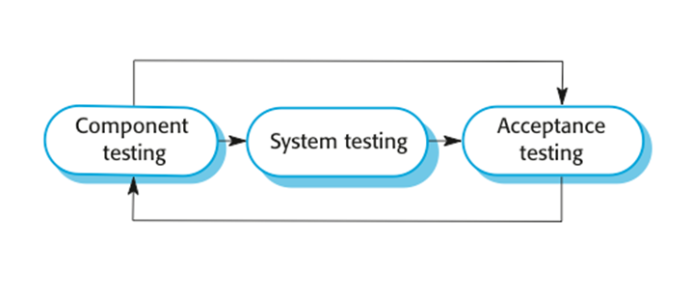
Stages of testing

Slide 28
Testing stages
Development or component testing
Individual components are tested independently;
Components may be functions or objects or coherent groupings of these entities.
System testing
Testing of the system as a whole. Testing of emergent properties is particularly important.
Acceptance testing
Testing with customer data to check that the system meets the customer’s needs.

Slide 29
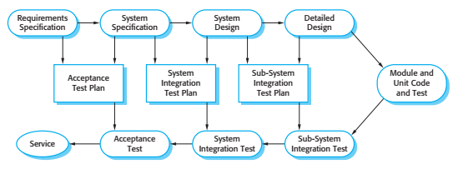
Testing phases in a plan-driven software process

Slide 30
Software evolution
Software is inherently flexible and can change.
As requirements change through changing business circumstances, the software that supports the business must also evolve and change.
Although there has been a demarcation (separation) between development and evolution (maintenance) this is increasingly irrelevant as fewer and fewer systems are completely new.

Slide 31
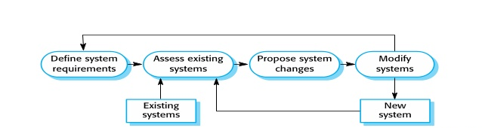
System evolution

Slide 32
Coping with change
Change is inevitable in all large software projects.
Business changes lead to new and changed system requirements
New technologies open up new possibilities for improving implementations
Changing platforms require application changes
Change leads to rework so the costs of change include both rework (e.g. re-analysing requirements) as well as the costs of implementing new functionality

Slide 33
Reducing the costs of rework
Change avoidance, where the software process includes activities that can anticipate possible changes before significant rework is required.
For example, a prototype system may be developed to show some key features of the system to customers.
Change tolerance, where the process is designed so that changes can be accommodated at relatively low cost.
This normally involves some form of incremental development. Proposed changes may be implemented in increments that have not yet been developed. If this is impossible, then only a single increment (a small part of the system) may have be altered to incorporate the change.
Notes:
Two ways of coping with changes:
1- prototyping system
2- incremental development

Slide 34
Software prototyping
A prototype is an initial version of a system used to demonstrate concepts and try out design options.
A prototype can be used in:
The requirements engineering process to help with requirements elicitation and validation;
In design processes to explore options and develop a UI design;
In the testing process to run back-to-back tests.

Slide 35
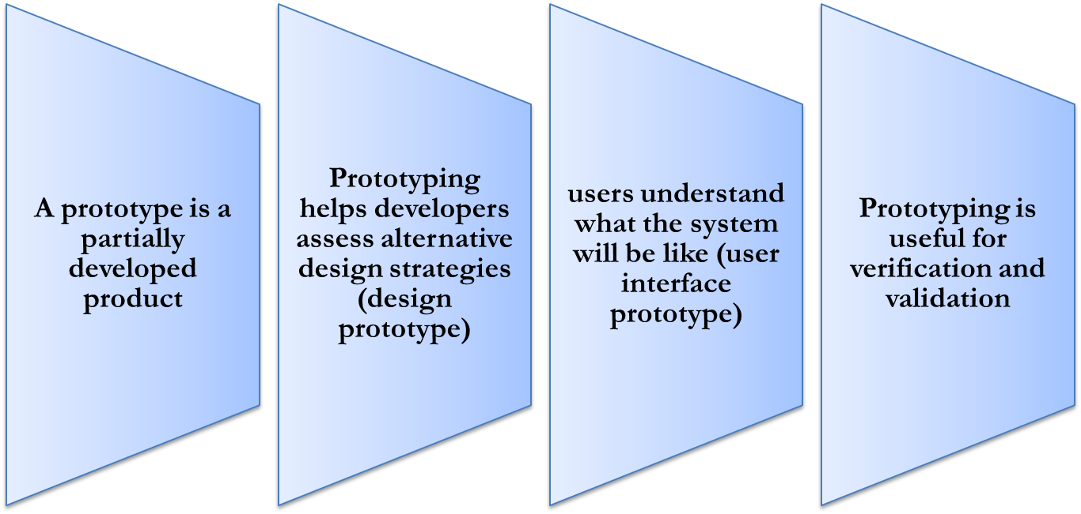
Software prototyping

Slide 36
Incremental delivery
Rather than deliver the system as a single delivery, the development and delivery is broken down into increments with each increment delivering part of the required functionality.
User requirements are prioritised and the highest priority requirements are included in early increments.
Once the development of an increment is started, the requirements are frozen though requirements for later increments can continue to evolve.

Slide 37
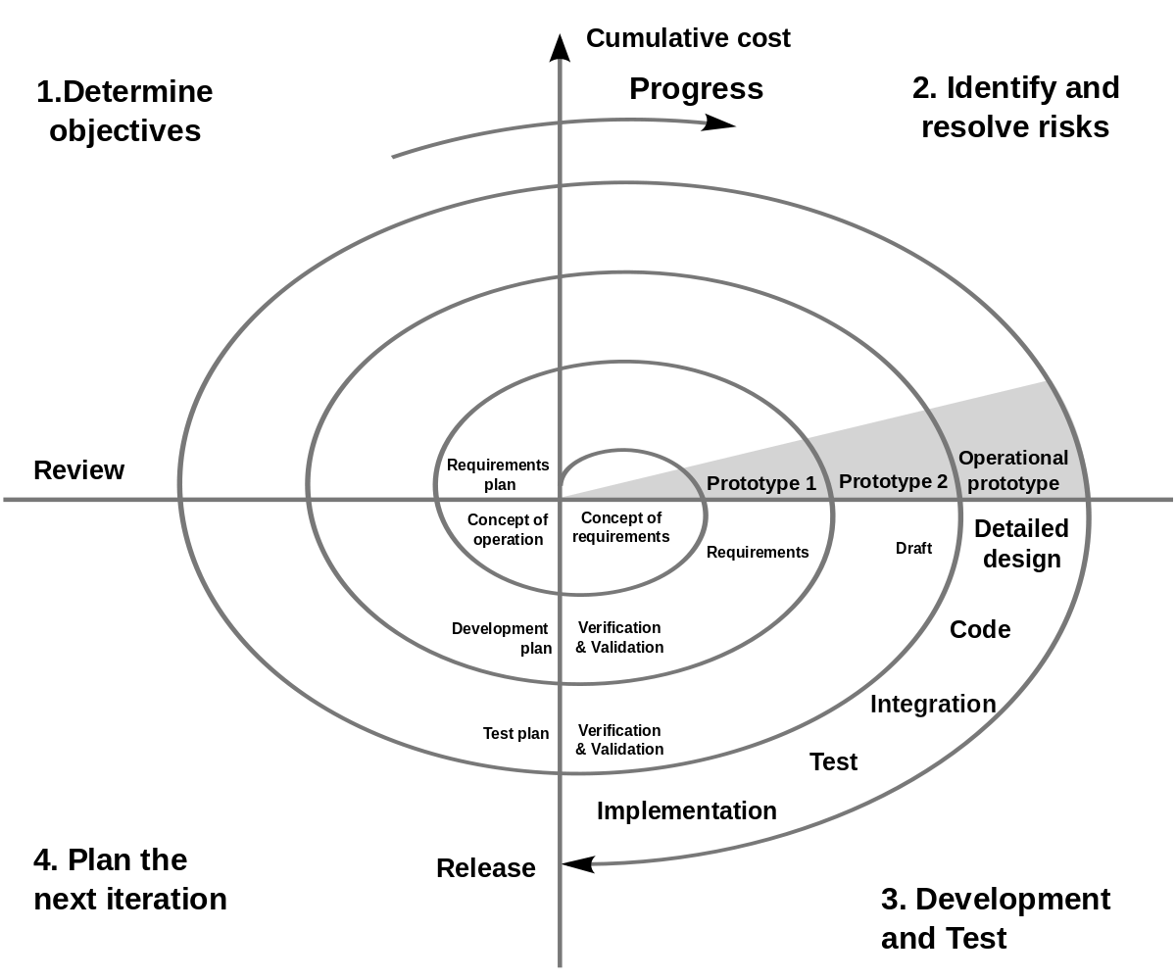
Boehm’s spiral model

Slide 38
Determine Goals, Alternatives & Constraints
Evaluate Alternatives & Risks
Collecting Requirements
and Preliminary Planning
Initial data
analysis
Analysis based on
Beneficiary
Responses
Planning based on
Beneficiaries Evaluation
Decision whether to continue or not?
Beneficiaries Evaluation
Start or Stop
Primary system model
Revised model of the system
Plan
Lecture #6
Develop & Test
Final Designed System
38

Slide 39
Thank you !!
Questions?

Slide 40
Reading

Slide 41
The Rational Unified Process
A modern generic process derived from the work on the UML and associated process.
Brings together aspects of the 3 generic process models discussed previously.
Normally described from 3 perspectives
A dynamic perspective that shows phases over time;
A static perspective that shows process activities;
A practive perspective that suggests good practice.

Slide 42
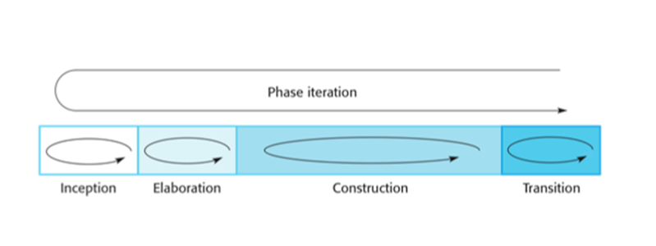
Phases in the Rational Unified Process

Slide 43
RUP phases
Inception
Establish the business case for the system.
Elaboration
Develop an understanding of the problem domain and the system architecture.
Construction
System design, programming and testing.
Transition
Deploy the system in its operating environment.

Slide 44
RUP iteration
In-phase iteration
Each phase is iterative with results developed incrementally.
Cross-phase iteration
As shown by the loop in the RUP model, the whole set of phases may be enacted incrementally.

Slide 45
Static workflows in the Rational Unified Process
Workflow | Description
Business modelling | The business processes are modelled using business use cases.
Requirements | Actors who interact with the system are identified and use cases are developed to model the system requirements.
Analysis and design | A design model is created and documented using architectural models, component models, object models and sequence models.
Implementation | The components in the system are implemented and structured into implementation sub-systems. Automatic code generation from design models helps accelerate this process.

Slide 46
Static workflows in the Rational Unified Process
Workflow | Description
Testing | Testing is an iterative process that is carried out in conjunction with implementation. System testing follows the completion of the implementation.
Deployment | A product release is created, distributed to users and installed in their workplace.
Configuration and change management | This supporting workflow managed changes to the system (see Chapter 25).
Project management | This supporting workflow manages the system development (see Chapters 22 and 23).
Environment | This workflow is concerned with making appropriate software tools available to the software development team.

Slide 47
RUP good practice
Develop software iteratively
Plan increments based on customer priorities and deliver highest priority increments first.
Manage requirements
Explicitly document customer requirements and keep track of changes to these requirements.
Use component-based architectures
Organize the system architecture as a set of reusable components.

Slide 48
RUP good practice
Visually model software
Use graphical UML models to present static and dynamic views of the software.
Verify software quality
Ensure that the software meet’s organizational quality standards.
Control changes to software
Manage software changes using a change management system and configuration management tools.

Slide 49
Key points
Processes should include activities to cope with change. This may involve a prototyping phase that helps avoid poor decisions on requirements and design.
Processes may be structured for iterative development and delivery so that changes may be made without disrupting the system as a whole.
The Rational Unified Process is a modern generic process model that is organized into phases (inception, elaboration, construction and transition) but separates activities (requirements, analysis and design, etc.) from these phases.

